Slide 1
Introduction to Computers
By UIRI ICT Team

Slide 2
What Is A Computer?
A computer is an electronic device, operating under the control of instructions (software) stored in its own memory unit, that can accept data (input), manipulate data (process), and produce information (output) from the processing. Generally, the term is used to describe a collection of devices that function together as a system.

Slide 3
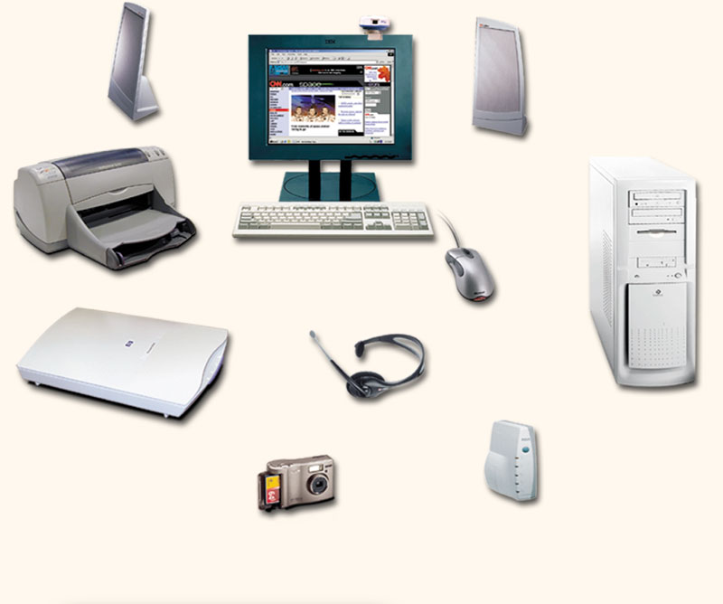
Devices that comprise a computer system
Monitor (output)
Speaker (output)
System unit
(processor, memory…)
Printer (output)
Storage devices
(CD-RW, Floppy, Hard disk, zip,…)
Mouse (input)
Scanner (input)
Keyboard (input)

Slide 4
Types of Computers
  Computer types according to capability are:
  Supercomputers
  Mainframes
  Servers
  Desktops
  Portables

Slide 5
Super computers
State-of-the-art machines designed to perform calculations as fast as the current technology allows
Used to solve extremely complex and large-scale problems: weather prediction, simulation of atomic explosions; aircraft design; movie animation
Cost tens of millions of dollars

Slide 6
The Champion: ASCI White
Most powerful computer as of February 2002
Capable of 12.3 trillion calculations/sec
74,000 times faster than Cray 1 (1976)
1,000 times faster than Deep Blue (1997)
Designed for complex 3-D simulations required for testing nuclear weapons
Powered by 8192 microprocessors
6 TB of memory; 160 TB of storage capacity

Slide 7
Mainframe Computers
Also called “Enterprise Servers”
Designed for performing multiple, intensive tasks for multiple users simultaneously
Used by large businesses (e.g. banks, e-commerce sites), military, and industrial organizations
Designed for very-high reliability
Cost in millions of dollars

Slide 8
Servers/Minicomputers
The name minicomputers used to define the class of computers that lies between personal computers and mainframes
Generally are more reliable than desktops, but not as solid as the mainframes
Costs in hundreds of thousands of dollars

Slide 9
Desktop Computers
Also called microcomputers
Low-end desktops are called PC’s and high-end ones “Workstations”
PC’s are used for running productivity applications, Web surfing, messaging
Workstations cost a few thousand dollars; PC around a $1000

Slide 10
Mobile Computers
Laptops, palmtops, and wearable computers are very capable computers but are lightweight and consume very little power

Slide 11
Laptops
Also called notebook computers
Generally weigh around 2kg
Use special low-power processors
Can work for more than 2 hours on battery.
Their usage is similar to that of PCs
They cost in the range of $1500-2500

Slide 12
Palmtops
also known as PDA’s - Personal Digital Assistants
Weigh less than a pound
have very low-power processors
KB’s of memory
MB’s of storage capacity
Can run for many hours on AA batteries
Used as an electronic version of a pocket diary
Also for Web surfing and e-mail or even as mobile phones
Palmtops cost $200-600

Slide 13
Wearables
are small in size & carried in a pocket
worn on the arm, waist or head or elsewhere on the body
Capability similar to PDA’s but more expensive
They are always ON, and always accessible. That is, the user can always enter and execute commands, even while walking around or doing other activities
Each soldier of the future will be fitted with one

Slide 14
What Does A Computer Do?
Computers can perform four general operations, which comprise the information processing cycle.
Input
Process
Output
Storage

Slide 15
Data and Information
All computer processing requires data, which is a collection of raw facts, figures and symbols, such as numbers, words, images, video and sound, given to the computer during the input phase.
Computers manipulate data to create information. Information is data that is organized, meaningful, and useful.
During the output Phase, the information that has been created is put into some form, such as a printed report.
The information can also be put in computer storage for future use.

Slide 16
Why Is A Computer So Powerful?
The ability to perform the information processing cycle with amazing speed.
Reliability (low failure rate).
Accuracy.
Ability to store huge amounts of data and information.
Ability to communicate with other computers.

Slide 17
How Does a Computer Know what to do?
It must be given a detailed list of instructions, called a compute program or software, that tells it exactly what to do.
Before processing a specific job, the computer program corresponding to that job must be stored in memory.
Once the program is stored in memory the compute can start the operation by executing the program instructions one after the other.

Slide 18
Motherboard
Many of the system unit’s components reside on a circuit board called the motherboard.
The motherboard contains many different types of chips, or small pieces of semiconducting material, on which one or more integrated circuits (IC) are etched.
An integrated circuit is a microscopic pathway capable of carrying electronic current.
Each IC can contain millions of transistors, which act as switches for electronic signals.

Slide 19
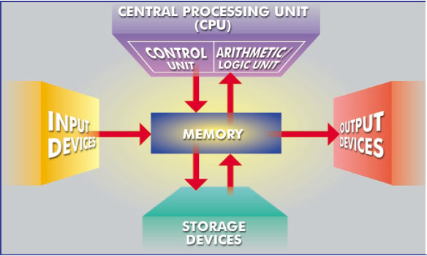
What Are The Primary Components Of A Computer ?
Input devices.
Central Processing Unit (containing the control unit and the arithmetic/logic unit).
Memory.
Output devices.
Storage devices.

Slide 20
Input
Input is any data or instructions entered into the memory of a computer.
Two types of input are data and instructions. Data is a collection of unorganized items that can include words, numbers, pictures, sounds, and video.
A computer processes data into information, which is organized, meaningful, and useful.
Instructions can be in the form of programs, commands, or user responses.

Slide 21
A program is a series of instructions that tells a computer how to perform the tasks necessary to process data into information.
A command is an instruction given to a computer program.
A user response is an instruction you issue to the computer by responding to a question posed by a computer program.

Slide 22
Input Devices
Any hardware component that allows you to enter data, programs, commands, and user responses into a computer is an input device.
Keyboard
The most familiar input device is the keyboard. Users type the text directly into the computer.

Slide 23
Mouse
The mouse is a point and click device. As you move the mouse across a surface, it senses this movement either mechanically or optically. This is translated into the movement of a pointer on the screen. Functions are represented as icons on the screen. When you click on these using a mouse button, the function is executed.

Slide 24
Touchpad & Trackball
A touchpad is a device that senses pressure to guide the pointer on the computer screen. It is generally a small square area below the keyboard. As the user moves his/her finger across the touchpad, the pointer moves on the screen. Next to the pad are two buttons used for clicking in exactly the same way as those on a mouse.
A trackball acts as a type of overturned mouse. The ball is on the top side of the object. By rolling the ball you can move the pointer across the screen. Some keyboards have an in-built trackball. The trackball has been superseded by the touchpad.

Slide 25
Light pen
A light pen is a device which is sensitive to variations in patterns on a surface. Light pens act like a miniature scanner and can read text as they are dragged across the printed page.
This can be transferred directly to the current open document.

Slide 26
Bar code
A bar code is a pattern of vertical lines in which the spacing and thickness can be used to represent data. A bar code reader is a device that can read and interpret bar codes and input the data into the computer.

Slide 27
Joystick
A joystick is a device that is familiar for use in games to move objects on the screen.
However, it is also used to control the movements in computerized industrial machines such as lathes. It consists of a small vertical lever which can move in any direction. These movements are translated to the computer which in turn uses them to control the movements of machinery.

Slide 28
Digital camera
A digital camera is used to take pictures and store the photographed images digitally instead of on traditional film. Pictures are stored on a storage medium, such as a PC Card, compact flash card, memory stick, mini-CD, or microdrive.
Many digital cameras allow you to review and edit the images while they are in the camera.
Microphone
A microphone translates speech into an electronic signal. Modern speech recognition software is able to translate this into either commands or data. This enables the user to use a microphone as an alternative to the keyboard.

Slide 29
Scanner
A scanner is similar to a photocopier, except that instead of producing a paper copy of the document you place on it, you get an electronic copy which appears on your computer screen. Text recognition software can be used with a scanner. This software is able to recognize the individual letters in the image. Instead of creating a single image of the document, the software inserts actual text into your application which can then be edited.

Slide 30
Central Processing Unit
  The central processing unit (CPU), also called a processor, significantly impacts overall computing power and manages most of a computer’s operations.
  The CPU contains the control unit and the arithmetic/logic unit. The control unit directs and coordinates most of the operations in the computer.

Slide 31
Control unit
  For every instruction, the control unit repeats a set of four basic operations called the machine cycle:
  (1) fetching the instruction or data item from memory
  (2) decoding the instruction into commands the computer understands
  (3) executing the commands, and, if necessary
  (4) storing, or writing the result to memory.

Slide 32
Arithmetic/logic unit
  The arithmetic/logic unit (ALU) performs the execution part of the machine cycle. Specifically, the ALU carries out three operations:
  Arithmetic operations – performing calculations, which include addition, subtraction, multiplication, and division
  Comparison operations – comparing data items to determine if the first item is greater than, equal to, or less than the other item
  Logical operations – working with conditions and logical operators such as AND, OR, and NOT

Slide 33
A bit and how a series of bits represents data
  Most computers are digital, meaning they understand only two discrete states: on and off.
  These states are represented using two digits, 0 (off) and 1 (on).
  Each on or off value is called a bit (short for binary digit), the smallest unit of data a computer can handle.

Slide 34
A byte
  Eight bits grouped together as a unit form a byte.
  A byte provides enough different combinations of 0s and 1s to represent 256 individual characters including numbers, letters of the alphabet, punctuation marks, and other characters.
  The combinations of 0s and 1s used to represent data are defined by patterns called coding schemes.

Slide 35
Coding schemes
  Popular coding schemes are ASCII, EBCDIC, and Unicode.
  Coding schemes make it possible for humans to interact with a digital computer that recognizes only bits. Every character you type on a keyboard is converted into a corresponding byte, a series of on/off electrical states the computer can process.

Slide 36
Computer Memory
  Memory is a temporary storage place for data, instructions, and information.
  Memory stores the operating system, application programs, and the data processed by application programs.
  A byte is the basic storage unit in memory.

Slide 37
Memory Measurement
  Memory size is measured by the number of bytes available for use.
  A kilobyte (KB or K) of memory is approximately one thousand bytes, a megabyte (MB) is approximately one million bytes, and a gigabyte (GB) is approximately one billion bytes.

Slide 38
Differentiate between the various types of memory
  RAM (random access memory) consists of memory chips that the processor can read from and write to.
  Most RAM is volatile memory, meaning that its contents are lost when the computer’s power is turned off.
  Two basic types of RAM chips are dynamic RAM and static RAM.

Slide 39
DRAM & SRAM
  Dynamic RAM (DRAM) must be re-energized constantly or it loses its contents.
  Static RAM (SRAM) is faster and more reliable than DRAM and has to be re-energized less often, but it is much more expensive.

Slide 40
Memory cache & ROM
  Memory cache, also called a cache store or RAM cache, improves processing time by storing frequently used instructions and data.
  ROM (read-only memory) refers to memory chips that only can be read and used; that is, they cannot be modified.
  ROM is nonvolatile memory (NVM), meaning that its contents are not lost when the computer’s power is turned off.
  A variation of the ROM chip, called programmable read-only memory (PROM), is a blank chip on which you can place items permanently.

Slide 41
Flash memory & CMOS
  Flash memory, also known as flash ROM or flash RAM, is nonvolatile memory that can be erased electronically and reprogrammed.
  Complementary metal-oxide semiconductor (CMOS) memory, another type of memory chip, stores configuration information about the computer and uses battery power to retain information when the power to the computer is off.

Slide 42
Output
  Output is data that has been processed into a useful form called information.
  Four types of output are text, graphics, audio, and video.
  Text consists of characters (letters, numbers, punctuation marks, or any other symbol requiring one byte of computer storage space) that are used to create words, sentences, and paragraphs.

Slide 43
Types of output
  Graphics are digital representations of nontext information such as drawings, charts, photographs, and animation (a series of still images in rapid sequence that gives the illusion of motion).
  Audio is music, speech, or any other sound.
  Video consists of images played back at speeds to provide the appearance of full motion. An output device is any computer component capable of conveying information to a user.

Slide 44
Output Devices
  An output device is any device that the computer uses to send the results of processing to the user.
  Visual Display Unit (VDU)
  Virtually all computers use some type of screen as their primary output device. There are two categories of screen: cathode ray tube and LCD.

Slide 45
Display Devices
  A display device is an output device that visually conveys text, graphics, and video information.
  Information shown on a display device is called soft copy because the information exists electronically and is displayed for a temporary period of time.
  Display devices include CRT monitors, LCD monitors and displays, gas plasma monitors, and televisions.

Slide 46
CRT & LCD CONT.
  A cathode ray tube (CRT) is a large, sealed, glass tube. The front of the tube is a screen coated with phosphor material that glows as an electron beam moves back and forth, which produces an image on the screen.
  LCD monitors and LCD displays use liquid crystal to present information on the screen.
  A liquid crystal display (LCD) has liquid crystals between two sheets of material. When an electric current passes through the crystals, they twist, causing some light waves to be blocked and allowing others to pass through, which creates the images.

Slide 47
CRT & LCD
  CRT screens: The cathode ray tube (CRT) type screen is usually called a monitor and makes use of the same technology as a television screen
  Solid state screens: Solid state screens, also known as LCD or Liquid Crystal Displays, make use of tiny transistors to emit light and create an image. They are usually called flat screens when used as separate units with desktops.

Slide 48
Gas plasma monitor
  Similar to an LCD display, a gas plasma monitor is a flat-panel display. A gas plasma monitor, however, substitutes a layer of gas for the liquid crystal material.
  When voltage is applied, the gas releases ultraviolet light that causes pixels on the screen to glow and form an image.

Slide 49
NTSC converter & HDTV
  An NTSC converter converts a computer’s digital signal into an analog signal that a standard television set can display.
  High-definition television (HDTV) is a type of television set that works with digital broadcasting signals and supports a wider screen and higher resolution than a standard television set.

Slide 50
Factors that affect the quality of a display device
  The quality of a CRT monitor depends largely on its resolution, dot pitch, and refresh rate. The quality of an LCD monitor or display depends primarily on its resolution.
  A CRT monitor’s screen is coated with tiny dots of phosphor material, called pixels, that glow when electrically charged to produce an image.
  Resolution, which describes the sharpness and clearness of that image, is related directly to the number of pixels a monitor can display.

Slide 51
Dot pitch & Refresh rate
  The greater the number of pixels the display uses, the better the quality of the image.
  Dot pitch, a measure of image clarity, is the distance between each pixel on a display. The smaller the distance between pixels (dot pitch), the sharper the image.
  Refresh rate is the speed that a monitor redraws images on the screen. Refresh rate should be fast enough to maintain a constant, flicker-free image.

Slide 52
Resolution
  An important characteristic of all screens is their resolution. Each point of light on the screen is called a pixel. The resolution of a screen is the maximum number of pixels that the screen can display For example, 800 x 600. The greater the resolution the better. Modern screens can display 1024 X 768 or better.
  Printers
  Printers produce a hard copy of the output on paper. There are three main types of printers: Dot matrix, Inkjet and Laser .

Slide 53
Printers
  A printer is an output device that produces text and graphics on a physical medium such as paper or transparency film.
  Printed information is called hard copy because the information exists physically and is a more permanent form of output.
  Printers can be grouped in two categories: impact and nonimpact.

Slide 54
Impact printers
  Impact printers form characters and graphics by striking a mechanism against an ink ribbon that physically contacts the paper.
  A dot-matrix printer is an impact printer that prints images when tiny wire pins on a print head mechanism strike an inked ribbon.
  A line printer is an impact printer that prints an entire line at one time. Two popular types of line printers are band printers and shuttle-matrix printers.

Slide 55
Nonimpact printers
  Nonimpact printers form characters and graphics without actually striking the paper. An ink-jet printer is a nonimpact printer that sprays drops of ink onto a piece of paper.
  A laser printer is a nonimpact printer that creates images using a laser beam and powdered ink, called toner.
  A thermal printer is a nonimpact printer that generates images by pushing electrically heated pins against heat-sensitive paper.

Slide 56
Special purpose printers
  Some printers are used for special purposes.
  A photo printer is a color printer that can produce photo lab quality pictures as well as printing everyday documents.
  A label printer is a small printer that prints on an adhesive type material that can be placed on a variety of items.
  A portable printer is a small, lightweight printer that allows a mobile user to print from a notebook or handheld computer while traveling.

Slide 57
Plotters
  Plotters are sophisticated printers used to produce high-quality drawings such as blueprints, maps, and circuit diagrams. A large-format printer, which operates like an ink-jet printer but on a larger scale, creates photo-realistic quality color prints.
  Plotters are usually used in conjunction with CAD (Computer Assisted Design) programs.
  These are used in everything from the design of ships and machines to buildings

Slide 58
Speakers and Headsets
  An audio output device produces music, speech, or other sounds.
  Two commonly used audio output devices are speakers and headsets.
  Most personal computers have an internal speaker that outputs low-quality sound.
  Many users add high-quality stereo speakers or purchase PCs with larger speakers built into the sides of the monitor. A woofer can be added to boost low bass sounds. A headset plugged into a port on the sound card allows only the user to hear sound from the computer.

Slide 59
Data projectors & fax machines
A data projector takes the image on a computer screen and projects it onto a large screen so that an audience of people can see the image.
Two smaller, lower priced data projectors are an LCD projector, which uses liquid crystal display technology, and
A digital light processing (DLP) projector, which uses tiny mirrors.
A facsimile (fax) machine transmits and receives documents over telephone lines.

Slide 60
Multifunction devices
A fax modem is a communication device that allows you to send (and sometimes receive) electronic documents as faxes.
A multifunction device (MFD) is a single piece of equipment that looks like a copy machine but provides the functionality of a printer, scanner, copy machine, and sometimes a fax machine.

Slide 61
A Terminal as both an input and output device
A terminal is a device that performs both input and output because it consists of a keyboard (input), a monitor (output), and a video card.
A dumb terminal has no processing power and cannot function as an independent device. Dumb terminals connect to a host computer that performs the processing and then sends the output back to the dumb terminal.
An intelligent terminal has memory and a processor that has the capability of performing some functions independent of the host computer.

Slide 62
Special-purpose terminals
Some special-purpose terminals perform specific tasks and contain features designed for a particular industry.
A point-of-sale (POS) terminal is a special-purpose terminal used to record purchases at the point where a consumer buys a product or service.
An automatic teller machine (ATM) is a self-service, special-purpose terminal used to access your bank account.

Slide 63
Storage media and Storage devices
A storage medium (media is the plural) is the physical material on which items are kept.
A storage device is the computer hardware that records and retrieves items to and from a storage medium.
Storage devices can function as sources of input and output.
When storage devices transfer items from a storage medium into memory – a process called reading – they function as sources of input.

Slide 64
Storage Devices
When storage devices transfer items from memory to a storage medium – a process called writing – they function as sources of output. Types of storage media include :
Floppy disks, hard disks, Compact discs, Tape, PC Cards , Microfilm, Microfiche
Microfilm and microfiche store microscopic images of documents on roll or sheet film.
Microfilm uses a 100- to 215-foot roll of film. Microfiche uses a small sheet of film, usually about four inches by six inches. Libraries and large organizations use microfilm and microfiche to archive relatively inactive documents and files

Slide 65
Floppy Disk
A floppy disk is a portable, inexpensive storage medium that consists of a thin, circular, flexible plastic disk with a magnetic coating enclosed in a square-shaped plastic shell.
A floppy disk drive (FDD) is a device that can read from and write on a floppy disk.
Figure 2.10. Diskette

Slide 66
Zip disk
A zip disk is a removable magnetic disk which fits into a special zip drive. The surface is coated with a special scratch resistant material which makes a zip disk a very robust storage device.
its capacity is much less than that of hard drives and tape drives which limits its use for very large amounts of data.

Slide 67
Tape Cartridge
Tape, one of the first storage media used with mainframe computers, is a magnetically-coated ribbon of plastic capable of storing large amounts of data and information at low cost.
Because it requires sequential access, or consecutive reading and writing of data, tape is used for long-term storage and backup.
(Floppy disks, hard disks, and compact discs all use direct access, which means you can locate a data item immediately, without having to move through all the items stored in front of it.)

Slide 68
DVD & Hard disk drive
The Digital Versatile Disk is a development of the storage technology of the CD ROM.
Using newer storage methods and higher quality media, a DVD can store about 4 Gb of data. This is enough to store a full length film.
Hard disk drive
A hard disk drive can be internal or external. An internal drive is housed inside the main unit and is connected directly to the motherboard of the computer.
An external drive is housed inside a special caddy which connects to the computer through one of its ports.

Slide 69
CD-ROMs, CD-RWs, and DVD-ROMs
A CD-ROM, or compact disc read-only memory, is a compact disc that uses the same laser technology as audio CDs.
For a computer to read items stored on a CD-ROM, you insert the disc into a CD-ROM drive or CD-ROM player.
When viewing animation or video, the speed of a CD-ROM drive, or data transfer rate, is important. A higher the data transfer rate, results in smoother playback of images and sounds.

Slide 70
Single session & Multisession
Most standard CDs are single-session because manufacturers record (write) all items to the disc at one time.
Variations of standard CD-ROMs, such as PhotoCD, CD-R (compact disc-recordable), and CD-RW (compact disc-rewritable), are multisession, which means additional data, instructions, and information can be written at a later time.
A PhotoCD is a compact disc that contains digital photographic images.
A CD-R (compact disc-recordable) is a multisession compact disc onto which you can record your own items.

Slide 71
A CD-RW (compact disc-rewritable) is an erasable disc you can write on multiple times.
A DVD-ROM (digital video disc-ROM) is an extremely high-capacity compact disc capable of storing from 4.7 GB to 17 GB.
In order to read a DVD-ROM, you must have a DVD-ROM drive. You also can obtain recordable and rewritable versions of DVD. A DVD-R (DVD-recordable) allows you to write on it once and read (play) it many times.
With the new rewritable DVD, called a DVD+RW, you can erase and record on the disc multiple times.

Slide 72
Flash memory and memory sticks
A new type of external memory is the flash disk or memory stick. This is a solid state device (no moving parts) that connects to the computer via the USB port. It provides a very fast and reliable method of storing data externally.

Slide 73
Enterprise storage system
An enterprise storage system is a strategy that focuses on the availability, protection, organization, and backup of storage in a company.
To implement an enterprise storage system, a company uses a combination of techniques.
A server stores items needed by users on a network. A RAID system ensures that data is not lost.
A tape library is a high-capacity tape system that works with multiple tape cartridges for storing backups of data, information, and instructions.

Slide 74
A CD-ROM jukebox holds hundreds of CD-ROMs that can contain application programs and data.
An Internet backup can store data, information, and instructions on the Web.
A network attached storage (NAC) is an easy way to add hard disk space to a network.
A storage area network (SAN) is a high-speed network that connects storage devices.

Slide 75
Software
Software is a program that controls a computer and makes it work.
Software is divided into two broad categories: ie
systems software and application software.
Systems software is the term used to described programs that enable the computer to function, improve its performance and access the functionality of the hardware.
Applications software is the term used for programs that enable the user to achieve specific objectives such as create a document, use a database, produce a spreadsheet or design a building .

Slide 76
Systems software
Systems software is further subdivided into operating systems and utilities
The operating system is the program that actually makes the computer operate.
Utilities are programs which either improve the functioning of the operating system or supply missing or additional functionality.

Slide 77
Startup process for a personal computer
Booting is the process of starting or restarting a computer.
When you turn on the computer, the power supply sends an electrical signal to devices located in the system unit.
The processor chip resets itself and looks for the ROM chip that contains the BIOS (basic input/output system), which is firmware that holds the startup instructions.

Slide 78
Process Cont.
The BIOS executes the power-on self test (POST) to make sure hardware is connected properly and operating correctly.
The POST results are compared with data in a CMOS chip on the motherboard. If the POST completes successfully, the BIOS searches for specific operating system files called system files.
Once located, the boot drive (the drive from which your personal computer starts), loads the system files from storage (the hard disk – usually drive C) into memory (RAM) and executes them.

Slide 79
Process Cont.
Next, the kernel of the operating system loads into memory and takes control of the computer.
The operating system loads configuration information. In Windows XP, the registry consists of several files that contain the system configuration information.
When complete, the Windows XP desktop and icons display, and programs in the StartUp folder are executed.

Slide 80
The operating system is the program that actually makes the computer operate.

Slide 81
Types of Operating Systems
A single user/single tasking operating system allows only one user to run one program at a time.
A multitasking operating system allows a single user to work on two or more applications that reside in memory at the same time.
A multi-user operating system enables two or more users to run a program simultaneously.
A multiprocessing operating system can support two or more CPUs running programs at the same time. With virtual memory (VM), the operating system optimizes memory by allocating a portion of a storage medium, usually the hard disk, to function as additional RAM.

Slide 82
Functions of the operating system
Most operating systems perform similar functions that include:
managing programs
managing memory
scheduling jobs
configuring devices
accessing the Web
monitoring performance
administering security.

Slide 83
Monitoring performance & managing programs
Accessing the Web may entail including a Web browser and e-mail program in the operating system. Monitoring performance helps to identify and solve system problems.
A performance monitor is a program that assesses and reports information about various system resources and devices.
A file manager performs such functions as formatting and copying disks; listing the files on a storage medium; checking the amount of used and unused space on a storage medium; organizing, copying, deleting, moving, and sorting files; and creating shortcuts (icons on the desktop that run a program when clicked).

Slide 84
Scheduling jobs , Spooling, Configuring devices & Device Driver
Scheduling jobs (operations the processor manages) involves determining the order in which jobs are processed.
Spooling increases efficiency by placing print jobs in a buffer (an area of memory or storage where data resides while waiting to be transferred) until the printer is ready, freeing the processor for other tasks.
Configuring devices establishes communication with each device in the computer.
A device driver is a small program that tells the operating system how to communicate with a device.

Slide 85
Functions of the operating system
Boot-up the computer.
Control the hard drives: This includes such features as formatting and defragmenting disks as well as saving files to and retrieving files from disk.
Control input devices such as keyboards, mice and scanners.
Control output devices such as the video display and printer.
The following list names some operating systems. They are grouped according to similarity.
Unix; Linux; Free BSD

Slide 86
Components of the Computer and Their Use
A computer consists of five primary hardware components:
Input devices
The central processing unit (CPU)
Memory
Output devices
Storage devices

Slide 87
Keyboard
A keyboard is used to transmit alpha/numeric data by typing. In addition to the standard keys in the typing area, an enhanced keyboard contains:
function keys that can be programmed to perform specific tasks
status lights that indicate modes that can be turned on and off by toggle keys (e.g., caps lock and num lock)
a numeric keypad that allows for rapid entry of numbers

Slide 88
Keyboard Cont.
arrow keys and other cursor-control keys (e.g., home, end, page up, and page down) that control the on-screen movement of the insertion point
special keys such as esc, shift, ctrl, and alt that have varying functions depending on the software

Slide 89
The Components of the System Unit
The system unit, sometimes called the chassis, is a box-like case housing the electronic components of a computer that are used to process data. System unit components include :
Processor
Memory module
Cards
Ports
Connectors

Slide 90
Expansion slots and cards in the system unit
  An expansion slot is an opening, or socket, where you can insert a circuit board into the motherboard.
  These circuit boards – called cards, expansion cards, boards, expansion boards, adapters, adapter cards, interface cards, add-ins, or add-ons -- add new devices or capabilities to the computer.
  Four types of expansion cards found in most computers are a video card, a sound card, a network interface card, and a modem card.

Slide 91
Video, Sound & NIC Cards
  A video card converts computer output into a video signal that is sent through a cable to the monitor, which displays an image.
  A sound card enhances the sound-generating capabilities of a personal computer by allowing sound to be input through a microphone and output through speakers.
  A network interface card (NIC) is a communications device that allows the computer to communicate via a network.

Slide 92
Modem card & Plug and Play
  A modem card is a communications device that enables computers to communicate via telephone lines or other means.
  Many of today’s computers support Plug and Play, a capability with which the computer automatically can configure expansion boards and other devices as you install them.

Slide 93
A port
  A cable often attaches external devices to the system unit.
  A port is the interface, or point of attachment, to the system unit.
  Ports have different types of connectors, which are used to join a cable to a device.
  Male connectors have one or more exposed pins, while female connectors have matching holes to accept the pins.
  Most computers have three types of ports: serial, parallel, and USB.

Slide 94
Serial, Parallel and USB Ports
  A serial port is a type of interface that connects a device to the system unit by transmitting data only one bit at a time. Serial ports usually connect devices that do not require fast data transmission rates, such as a mouse, keyboard, or modem.
  A parallel port is an interface that connects devices by transferring more than one bit at a time. Many printers connect to the system unit using a parallel port.
  A universal serial bus (USB) port can connect up to 127 different peripheral devices with a single connector type, greatly simplifying the process of attaching devices to a personal computer.

Slide 95
Application & System software
  Application software consists of programs designed to perform specific tasks for users.
  System software consists of programs that control the operations of a computer and its devices. System software serves as the interface between a user, the application software, and the computer’s hardware.

Slide 96
Types of Personal Computer Application Software
  The more popular application software includes:
  Word processing software
  Electronic spreadsheet software
  Database software
  Presentation graphics software
  Communications software
  Electronic mail software

Slide 97
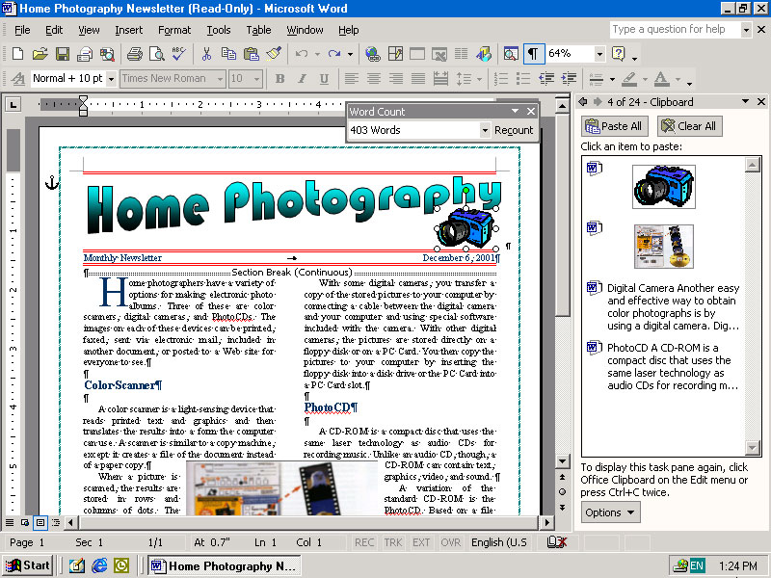
Word Processing
Word Processing software is used to create and print documents. A key advantage of word processing software is that users easily can make changes in documents.

Slide 98
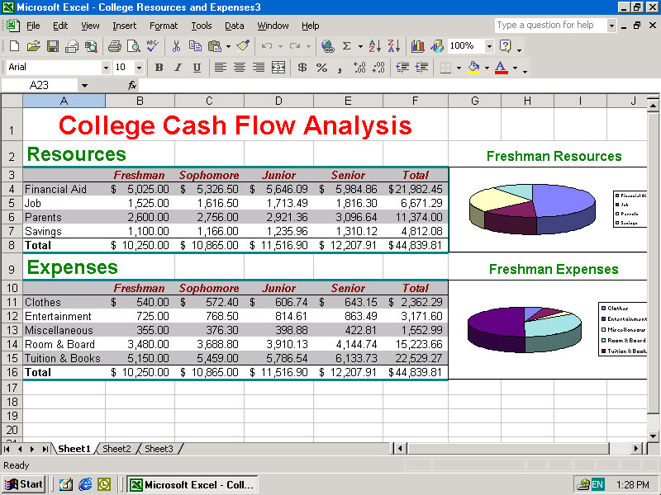
Electronic Spreadsheets
Electronic spreadsheet software allows the user to add, subtract, and perform user-defined calculations on rows and columns of numbers. These numbers can be changed and the spreadsheet quickly recalculates the new results.

Slide 99
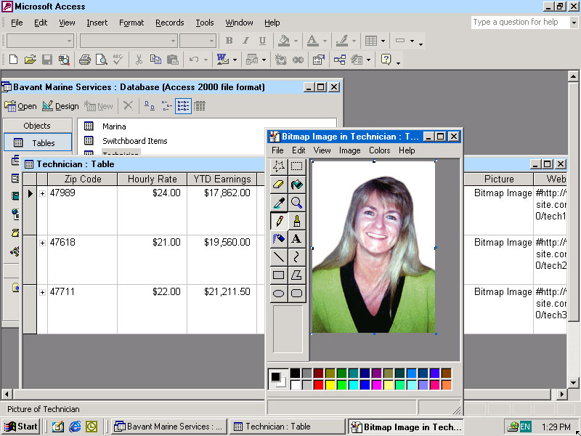
Database Software
Allows the user to enter, retrieve, and update data in an organized and efficient manner, with flexible inquiry and reporting capabilities.

Slide 100
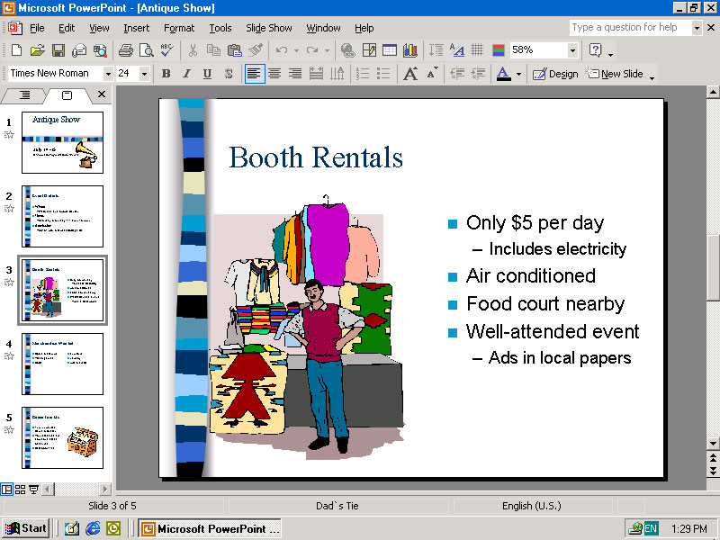
Presentation Graphics
Presentation graphic software allows the user to create documents called slides to be used in making the presentations. Using special projection devices, the slides display as they appear on the computer screen.

Slide 101
Uses of Computers in daily life

Slide 102
Computers in Education
Computers have sparked a revolution in education sector. Computers can give life like presentation to students through which concepts and ideas can be more easily conveyed to students especially those in the school level.
Today, computers can be found in libraries, class rooms and museums as a means of education. The terms CAL (Computer Assisted Learning) and CAI (Computer Aided Instructions) have become synonymous with school education.

Slide 103
Education Cont.
Some of the key advantages in using computers in education :-
Interactive and tailored operation is possible based on student needs.
Students can develop science projects using software.
Students can search large databases on interesting subjects.
Interactive tutorials with feedback can be used for assessing student
performance.

Slide 104
Computers in Communication
The merging of computers and communication has resulted in computer networks. Computer network provides a powerful means of communication.
Access to remote information, database sharing are some of the benefits of network.
Computer networks also offer a variety of communication facility for people Access to remote information and person- to-person communication are two important uses in this regard.

Slide 105
Communication Cont.
E-Mail is widely used by people to exchange message electronically.
Video-conferencing makes it possible to have virtual meetings, people in far away places.
ISDN or Integrated Services Digital Network facilitates all kinds of information transfer including data, voice, picture, radio in one channel.
E-Commerce is the integration of communication, data management and security capabilities to allow business application within different organizations to automatically exchange information related to sale of goods and services.

Slide 106
Computers in Science and Research
The enormous speed and accuracy of computers make them suitable for applications in scientific research.
In Bio-technology computers are used in the study on analysis of genetic behavior, study of genes and their structures. The ‘Human genome project’ is an example of this.
In chemical research, molecular modeling and study of chemical reaction is an application area.

Slide 107
Science and Research Cont.
Research and analysis of Astronomical data is another use of computer. Space scientists can predict events that may occur such as appearance of comets, changes in the orbit of planets and various solar phenomena. Computers are also used in research for new materials in aerospace technology.
In Medical field computers are used for research for new vaccines and diagnosis of diseases. Computers are used in modern bio-medical instrumentation.

Slide 108
Computers in Law
The legal profession has begun to make extensive use of computers. Computers help to search quickly through huge collections of data related to cases in databases.
Databases can be created containing thousands of documents of evidence. Comprehensive case files can be computerized.
Computers are also used for law enforcement like identifying vehicles violating traffic rules and building criminal databases by crime type.

Slide 109
Law Cont.
The National Crime Record Bureau(NCRB) has its own computer facilities for analysis on crimes. This is linked to various centers across the country.
Computers are employed in identifying criminals by finger print analysis and DNA fingerprinting. DNA fingerprinting technology can identify a person from traces of blood, skin or hair from crime spots.

Slide 110
Computers in Engineering
A computer can be used to perform long sequence of computation that could never be performed by people, because of human tendency to commit errors. Such situations commonly arise in Mathematics and Engineering.
Computers are used mainly to solve mathematical problems in engineering. They are also used as a tool for engineering design.
The advantage of using computers in this context is that of speed and accuracy.

Slide 111
Engineering Cont.
Computers can be used to simulate models of machine before they are actually built. This helps to improve their design.
In Electronics Engineering, Computers are used for design and analysis of circuits. Software is available for circuit design. This helps to study a circuit without actually assembling it.
In Nuclear Engineering, computers are used to control reactors using robots.
In Mechanical Engineering, computers are used to calculate the load, stress and strain to determine material strength requirements.

Slide 112
Computers in Manufacturing
Computers have become very essential in manufacturing systems.
Computer Aided Manufacturing(CAM) can be defined as the use of computer systems to plan, manage and control operations of a manufacturing plant through either direct or indirect computer interface with production resources.
Computer controlled analysis are employed in the manufacture of products ranging from tiny electronic components to automobiles and even aircrafts or ships.

Slide 113
Manufacturing Cont.
There are some significant advantages in using computers in design and manufacturing. Computer controlled tools can make parts that are closer to actual design specifications. This is not possible to be conventional tools.
Computers are also used in quality control in manufacturing environments.

Slide 114
Computers in Enforcement
Computers find applications in law enforcement. For example computers can be employed in monitoring the speed of vehicles.ie , detection of over speed.
This is done by employing a digital video camera interfaced with a computer. The camera will be able to follow a specific target, such as a vehicle and detect its speed.
Computers can be used to monitor data communications in a network and detect any unlawful communications.

Slide 115
Enforcement Cont.
Computer can be used to maintain large criminal databases. When a crime is detected it is possible to search available data on criminals based on nature of the crime.
Computers are also employed to establish scientific evidence in criminal cases. Technologies like finger print analysis and DNA finger printing make use of computers.
Enforcement of Tax laws is another area where computers can be effectively used. Large databases on taxpayers can be maintained for scrutinize and investigations.

Slide 116
Computers in Entertainment
Computers also contribute to entertainment. Various means of entertainment for children are computer games, interactive video, video games, flight stimulators and electronic puzzles. Some software help students learn through enjoyment.
Computers are used in music synthesis, film making and animations in cartoon films. In film making computer graphics and virtual reality modeling is used to create scenes, which cannot be really produced. This gives exciting special effects.

Slide 117
Entertainment Cont.
Multimedia systems combine text, graphic, music, voice and video movies to form an integrated platform.
One interesting application of multimedia technology in education and entertainment is the electronic encyclopedia. Such an encyclopedia contains colorful images and animations in addition to description in text.
It also facilitates easy navigation through hyperlink. A hyperlink is a highlighted text or image ,which is linked to some pages containing information.

Slide 118
Computers in Government
Governments can collect, process and store vast amounts of information about their citizens.
Government departments can computerize their functions and services. The major areas are that of taxation, revenue and treasuries.
Land records data can be stored in computer data bases for easy access.
Movements of files and proceedings on various subjects can be easily controlled and monitored.

Slide 119
Government Cont.
Computers can be used as ideal tools in planning and resource management.
The practice of integrating computers and communication technology for the benefit of government functions is termed E-Governance.
E-Governance centers on establishing a computer network that could serve as the basic electronic infrastructure for administrative functions of the government and then developing and implementing network-centric applications on top of this infrastructure .

Slide 120
Computer in Defence
Computers have a connection with defence and military organizations from the early days of their first generation.
The first electronic computer ENIAC (Electronic Numerical Integrator And Calculator) was used to compute artillery shell trajectories .
Today computers on–board ship, submarines and airplanes are linked to land based control facilities for coordinating military operations.
.

Slide 121
Defence Cont.
Real time system have been employed in monitoring military movements on boarders and strategically important places.
Missile and radar systems are computer controlled. The tremendous speed of computers make it suitable to give immediate response to actions required in defence.
Missile systems need to perform millions of computations for tracking targets.

Slide 122
Defence Cont.
Anti-missile systems use Real Time systems to track and intercept missiles in the itself before they bombard the target.
War planes are also computer controlled. There are already a number of spy satellites around the world that works as ‘Secret Eyes’ for defence.

